Slide 1
IoT Elderly Care Solution
Group sddec19-18: Robert Guetzlaff, Tyler Borchert, Siyuan Zeng, Nidhi Dalvi, Jared Griffin
Client: Optical Solutions
Advisor: Daji Qiao
Team Website: http://sddec19-18.sd.ece.iastate.edu/
Notes:
Jared, everyone introduces selves
Slide number
Font size too small -(increase)
Outline page at the beginning
First -Project focus( Group all of them)
Second - Survey, risks management, technology used( group them)
Third - Plan - Gantt chart , milestones, Status, next semester
First focus on the sensors( Hardware) then web and logic

Slide 2
Outline
Focus and Goal
Research
Plan and Progress
Notes:
Jared
Scope of the project what has been done by our group

Slide 3
Focus & Goal

Slide 4
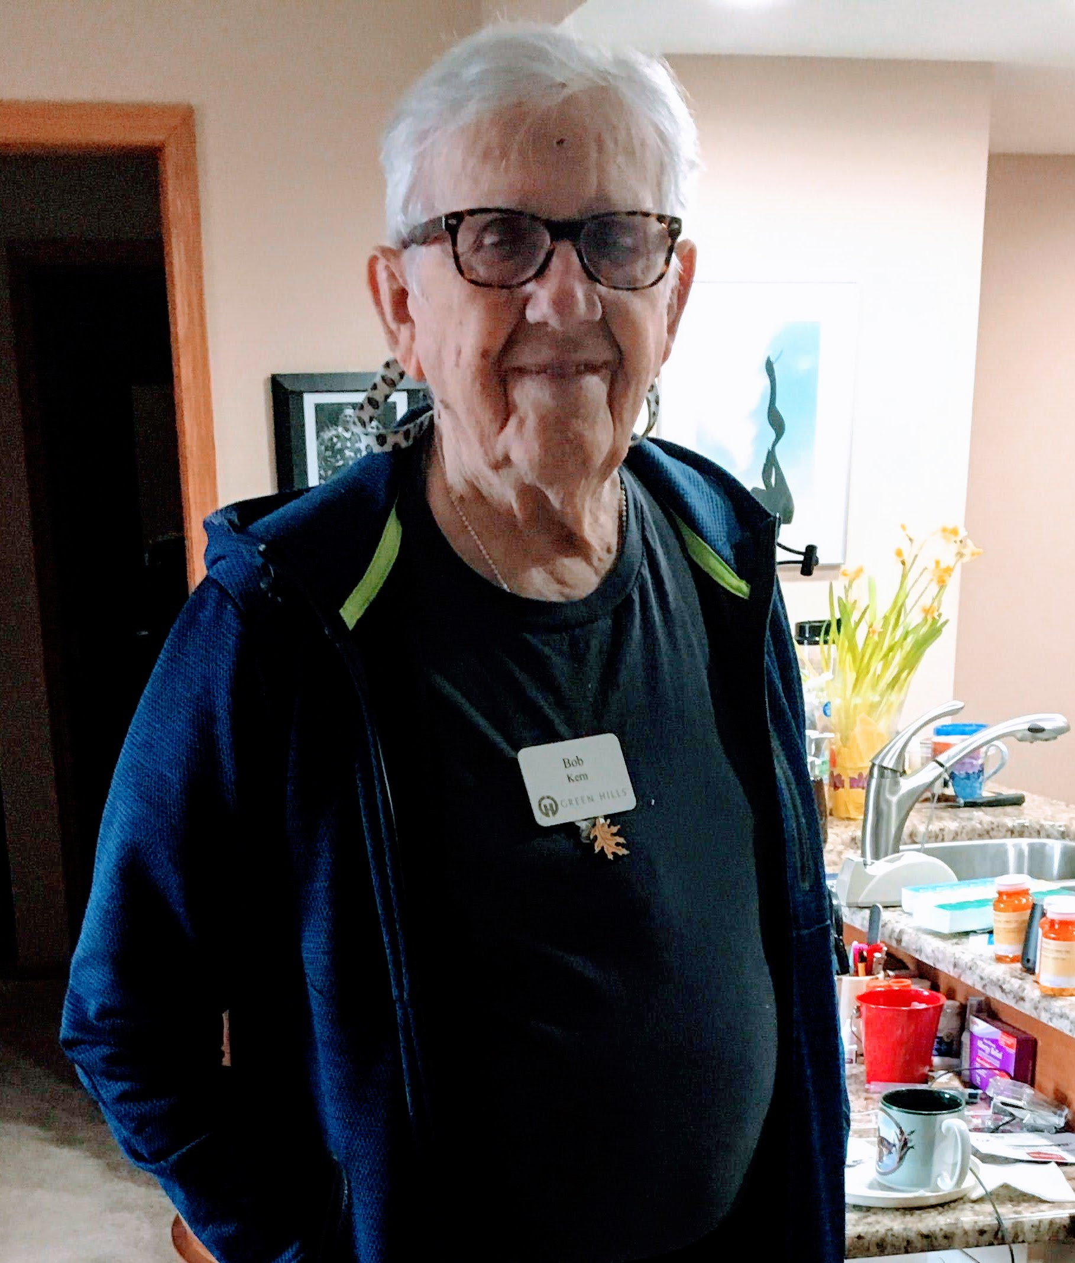
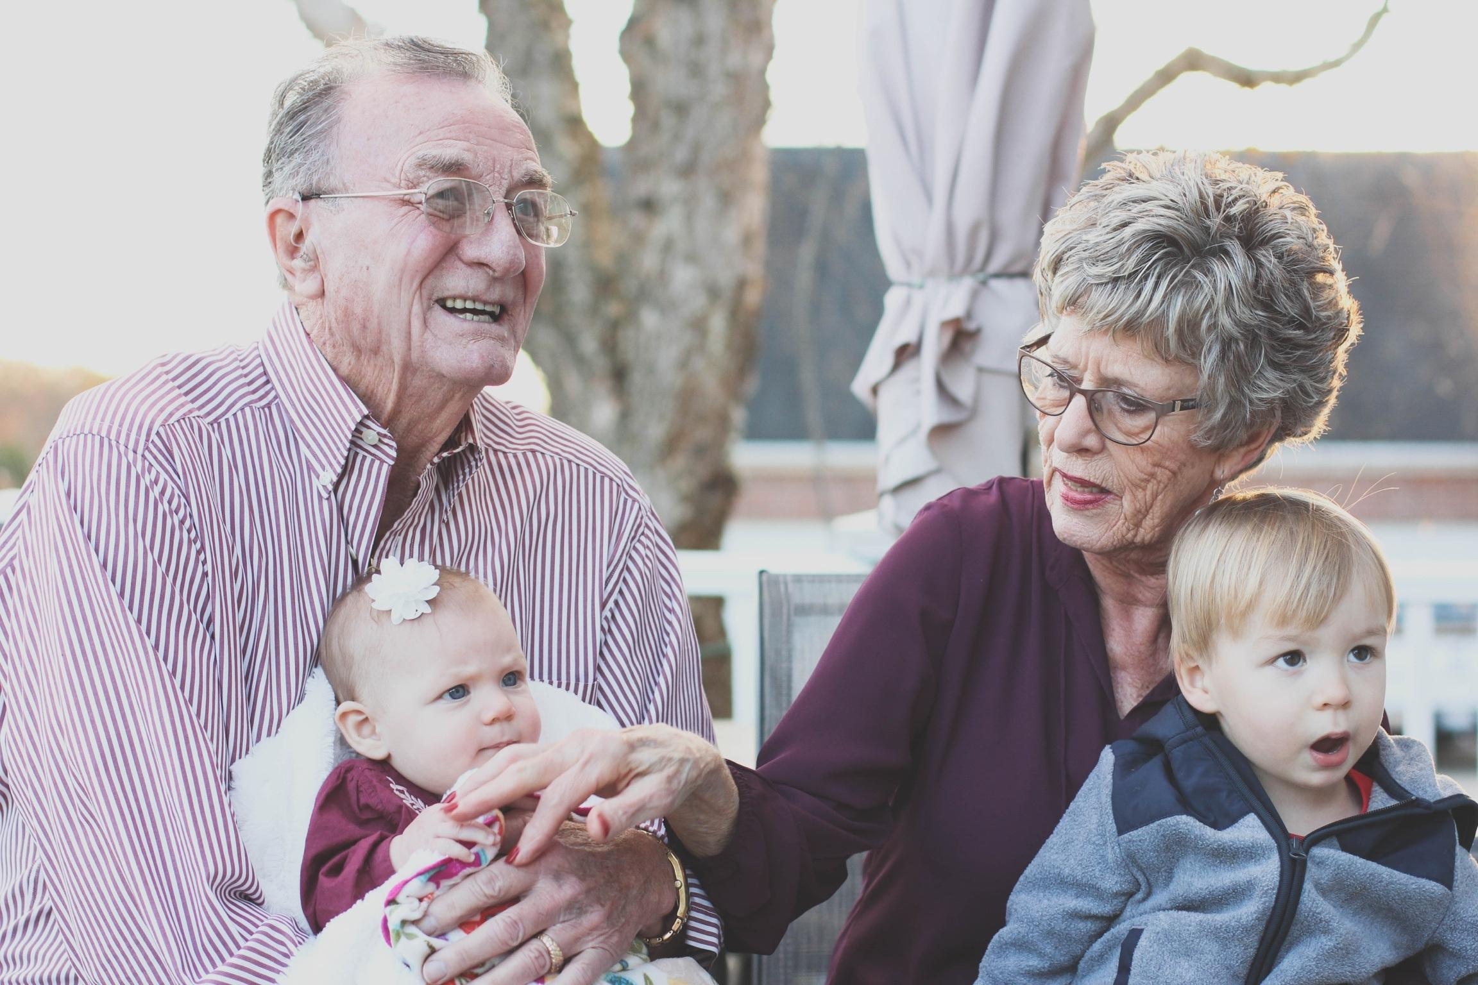
Problem Statement
How can senior citizens stay in their homes longer?
[1]
Notes:
Robert
One of the reasons senior citizen have to move to assisted living is that they are unable to take care of their health. Once someone notices a health problem it may be too late.
This is Bob, was the first resident Greenhills Community south of town. He is our test user for this project. His nearest family is 400 miles away and he is 95 years old living independently.
Our project aims to be able to detect health problems in their early stages, before they force Bob into assisted living.

Slide 5
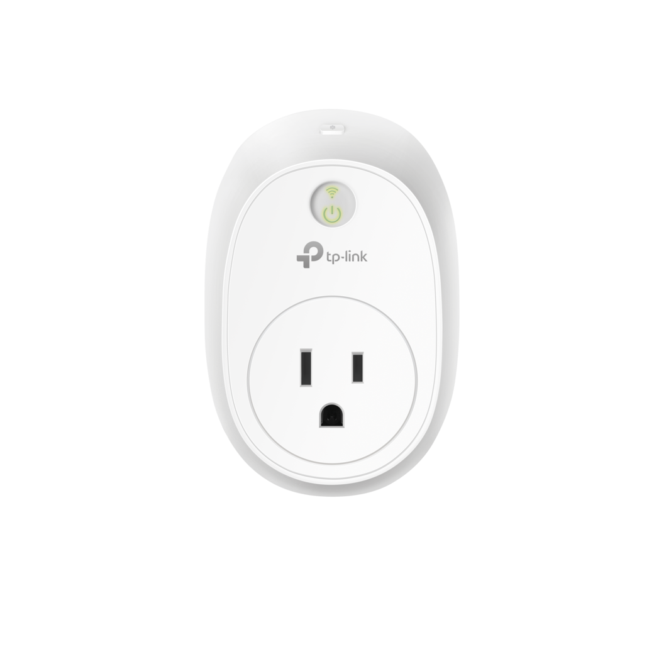
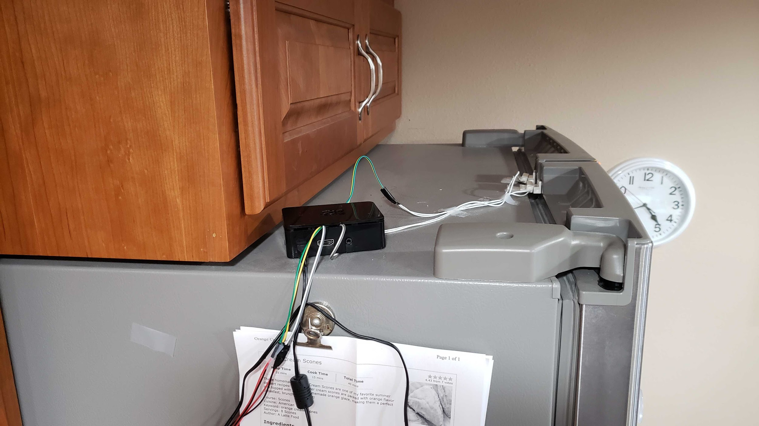
Previous Groups
Autonomous Animals
Built the initial system prototype for collecting kitchen usage data
Ran into a number of issues reliably collecting kitchen data
Guardians of the Grandparents
Created an Android application consuming stored data
Installed flow meter and smart outlet
[21]
Notes:
Tyler
We inherited this project from a previous group called Autonomous animals. They implemented the current wired solution in use today and our goal is to implement a wireless solution.
We were also working along with another group that created an android application and added more sensors to the project such as a wireless outlet.

Slide 6
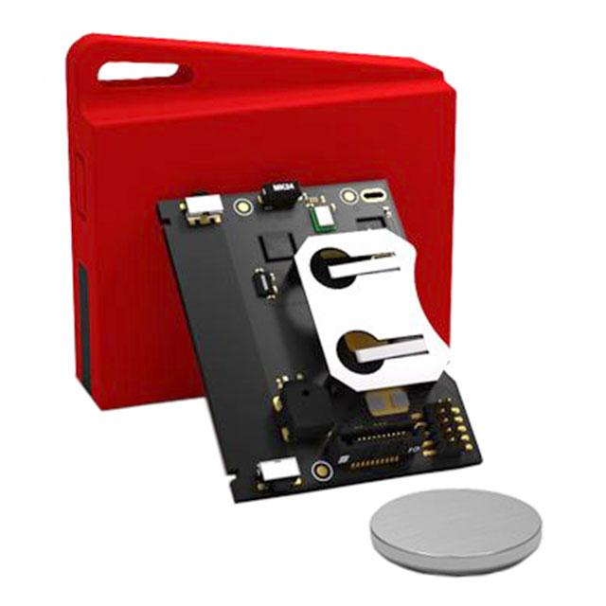
Functional Requirements
Sensors generate data matching our expected model
Display sensor event data through a web application
The sensor solution is wireless with a battery life of 1-2 years
Logic detects if a resident has a health anomaly
[8]
Notes:
Nidhi
Here are the functional requirements for our project. Talking about sensors it can generate data matching our expected model also display sensor data through a web application.The solution is wireless and non-invasive and the battery life is 1-2 years. On the logic side it detects is the resident is in a good or proper condition.

Slide 7
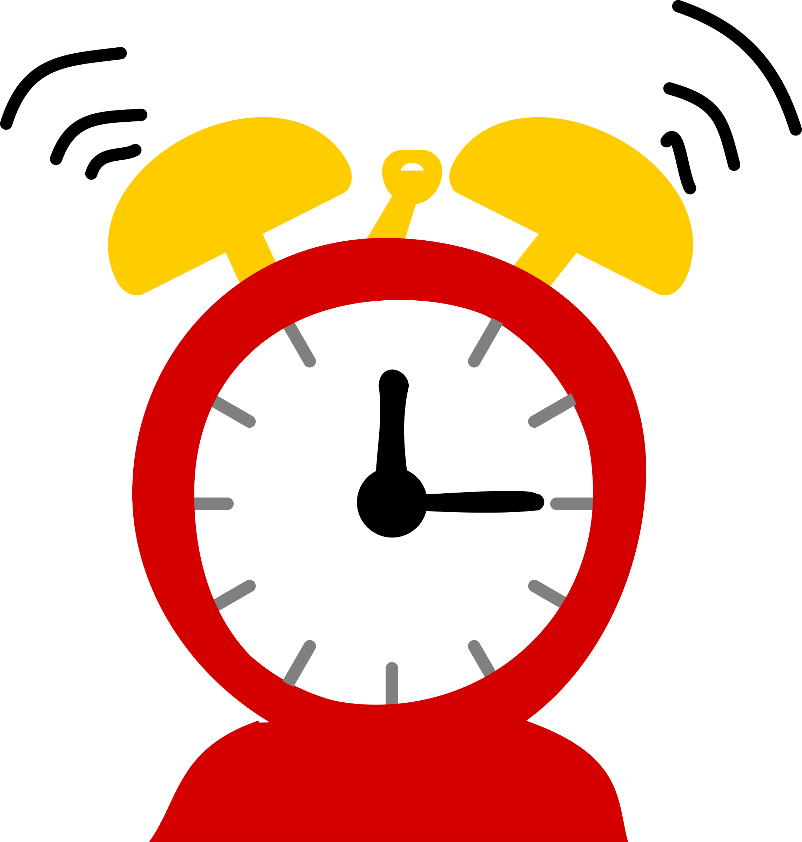
Non-functional Requirements
[22]
[23]
Reuse
Non-Invasive
[20]
[19]
Timely
Loss of Power
Notes:
Nidhi: Our goal is to reuse the previous group’s work, next is to make end door sensor solution wireless which means non-invasive, another goal is to analysed the data in timely manner and lastly if the internet loses its connection cz of loss of power system should handle an unexpected reboot.

Slide 8
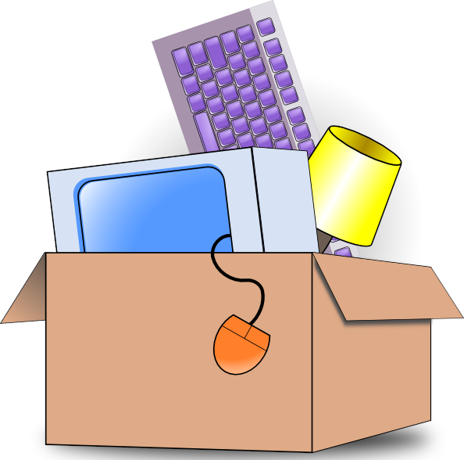
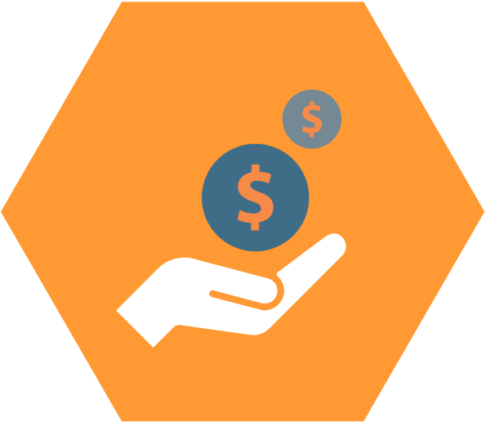
Constraints & Considerations
Cost
[2]
Sensor limitations
[3]
Inherited components
[4]
Notes:
Jared

Slide 9
Research

Slide 10
Market Survey
[5]
Notes:
Siyuan(todo)
There is an existing market product called vitalCare.
VitalCare is A cloud-based platform that monitor patient health and wellness through connected devices. Compared to our project, vitalTech collects the data to show the senior’s meal, heartbeats and etc. It is more like minitoring. Our project collect the data to predict the potential health risks such as the senior might have a stomachache, sleepy status in the next day so that we can send a alert to the senior’s family or doctor.

Slide 11
Potential Risks & Mitigation
Connection to the Cloud Environment
[6]
[7]
Remote Test Environment
Notes:
Robert

Slide 12
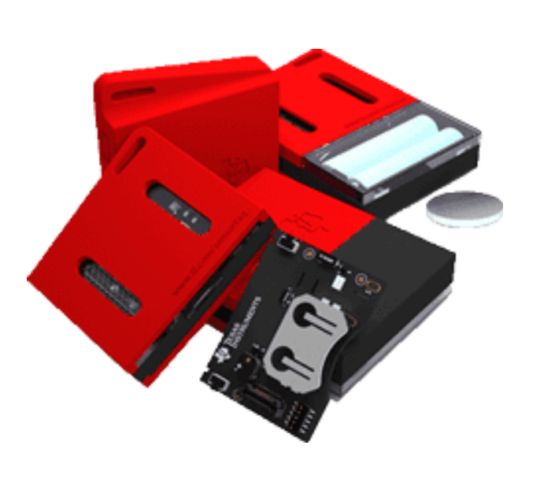
Resource/Cost Estimate
AWS Cloud Resources
EC2 Server: $0.0208/hr [11]
RDS Database: $0.017/hr [12]
S3 Bucket: $0.0237/GB [13]
Sensors:
$29 per TI Sensor Tag
$35.64 per Raspberry Pi 3
Notes:
Jared
Cloud Resources: free until September, so those are estimates

Slide 13
Plan & Progress

Slide 14
Member Roles & Responsibilities
Jared Griffin
Web Application Engineer, Project Website Maintainer, GitLab Administrator
Nidhi Dalvi
Hardware Engineer, Meeting Facilitator
Tyler Borchert
Hardware Engineer
Siyuan Zeng
Behavioral Logic Server Engineer
Robert Guetzlaff
Behavioral Logic Server Engineer and Database Management
Notes:
Hello everyone, I am Nidhi Dalvi majoring in computer engineering. For this project i am responsible for hardware and meeting facilitator.

Slide 15
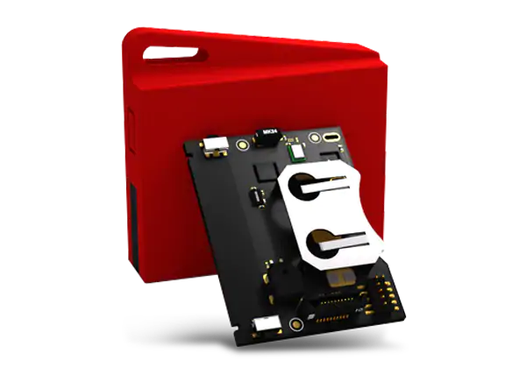
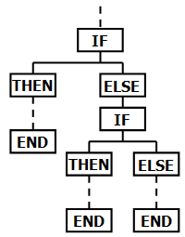
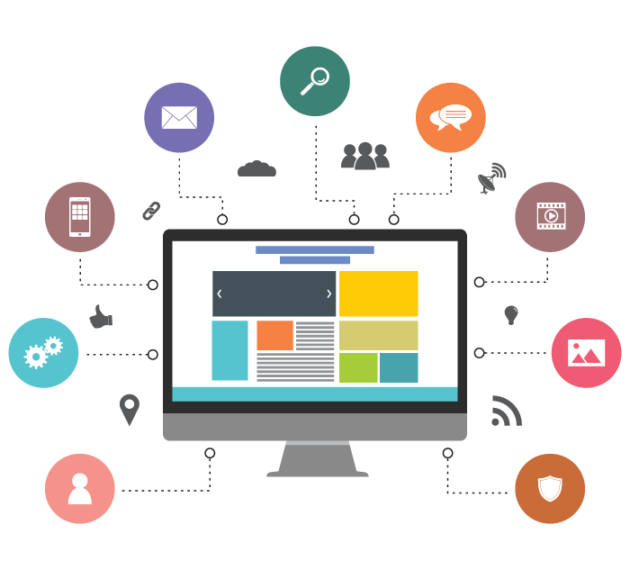
Functional Decomposition
[8]
[9]
[10]
Sensors/hardware
Behavioral Logic
Web Application
Notes:
Tyler
The system is split into three different parts.
The first being sensors and hardware. This will consist of wireless sensor tags the collect kitchen data from doors and cabinets. This data is then sent to the AWS server to the
behavioral logic.
Here we use predictive algorithms to predict whether the user consumed food given sensor data that was produced.
The web application takes the raw data from the sensors and from the behavioral logic to display in a nice format.

Slide 16
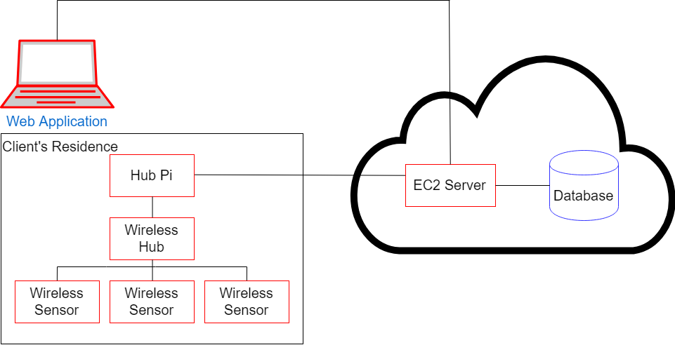
Detailed Design
Notes:
Jared, Robert, Tyler
(Insert slide above with system diagram)
Web application
Serves as primary user interface
Communicates with the logic and database servers through HTTP requests
Behavioral logic
Hardware & sensors

Slide 17
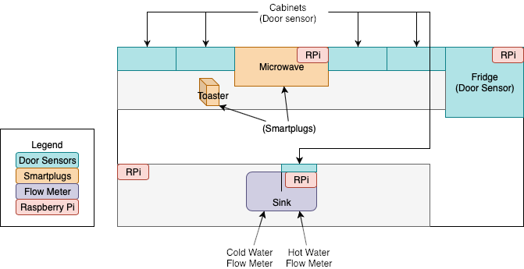
Test Environment
Notes:
Tyler
This is a diagram of the testing environment which is set up at Green Hills Retirement community in an independent living apartment. We currently have wired sensor attached to many cabinets and doors in the kitchen. Each of these communicate to a raspberry pi to then be sent off to the server we have in place.

Slide 18
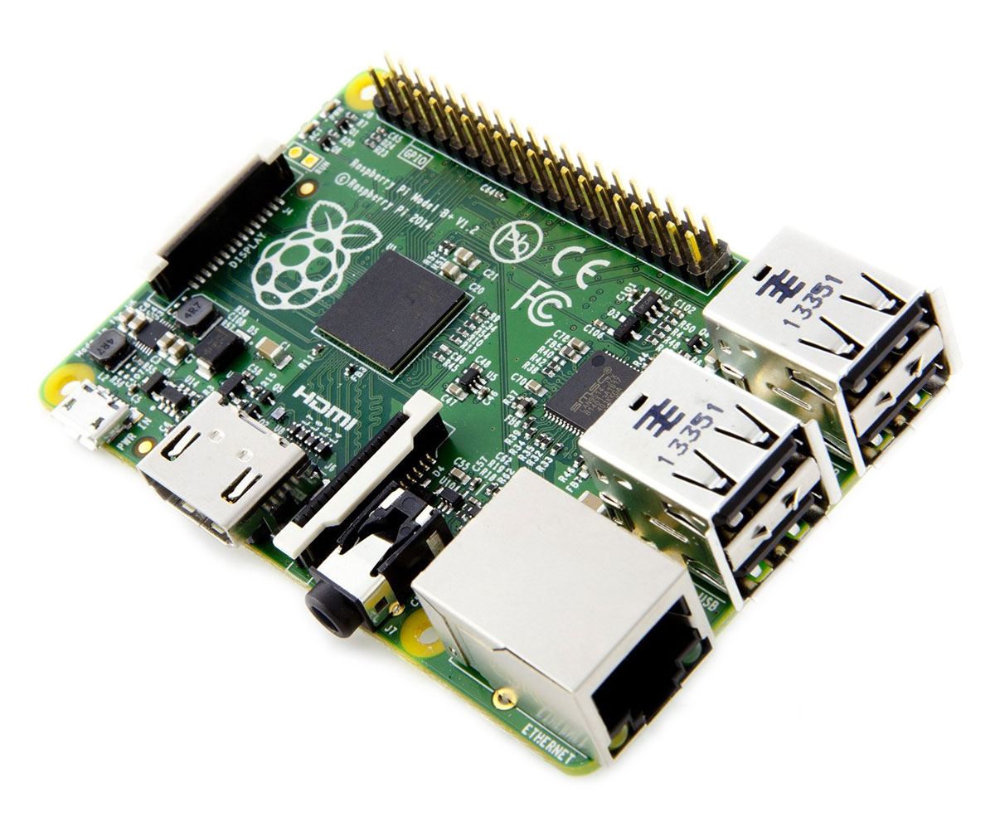
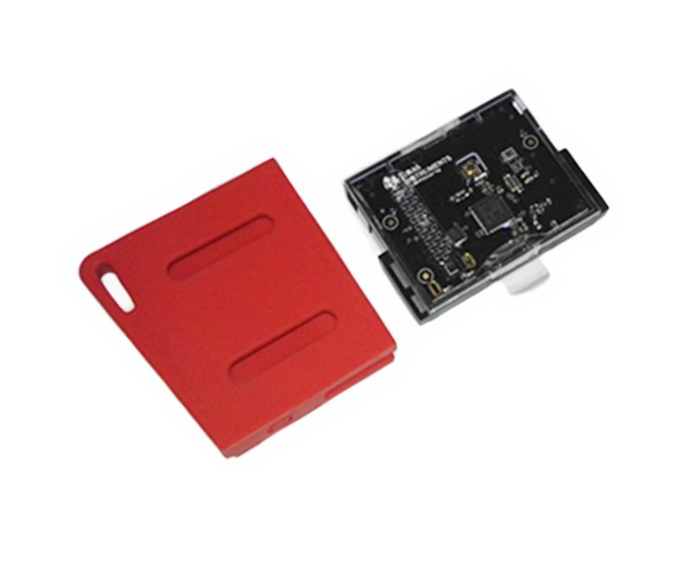
Technology Used
Technology Platforms
AWS
EC2
RDS
S3
Hardware
Raspberry Pi TI sensor tag
Software
Web Application
React
Jest
Logic Server
Spring Server
Eclipse
Hardware
VNC
Python
Notes:
Jared - Tech platforms
Nidhi - Hardware
Raspberry pi is a very small computer (tiny computer).
Ti sensor tag - For the future implementation we will be using TI sensor tag
VnC is a remote desktop connection software to allow remote connection to the testing environment
Python- this is what we are using for processing sensor input data and communication.
Jared - Web app software
Siyuan - Logic server software

Slide 19
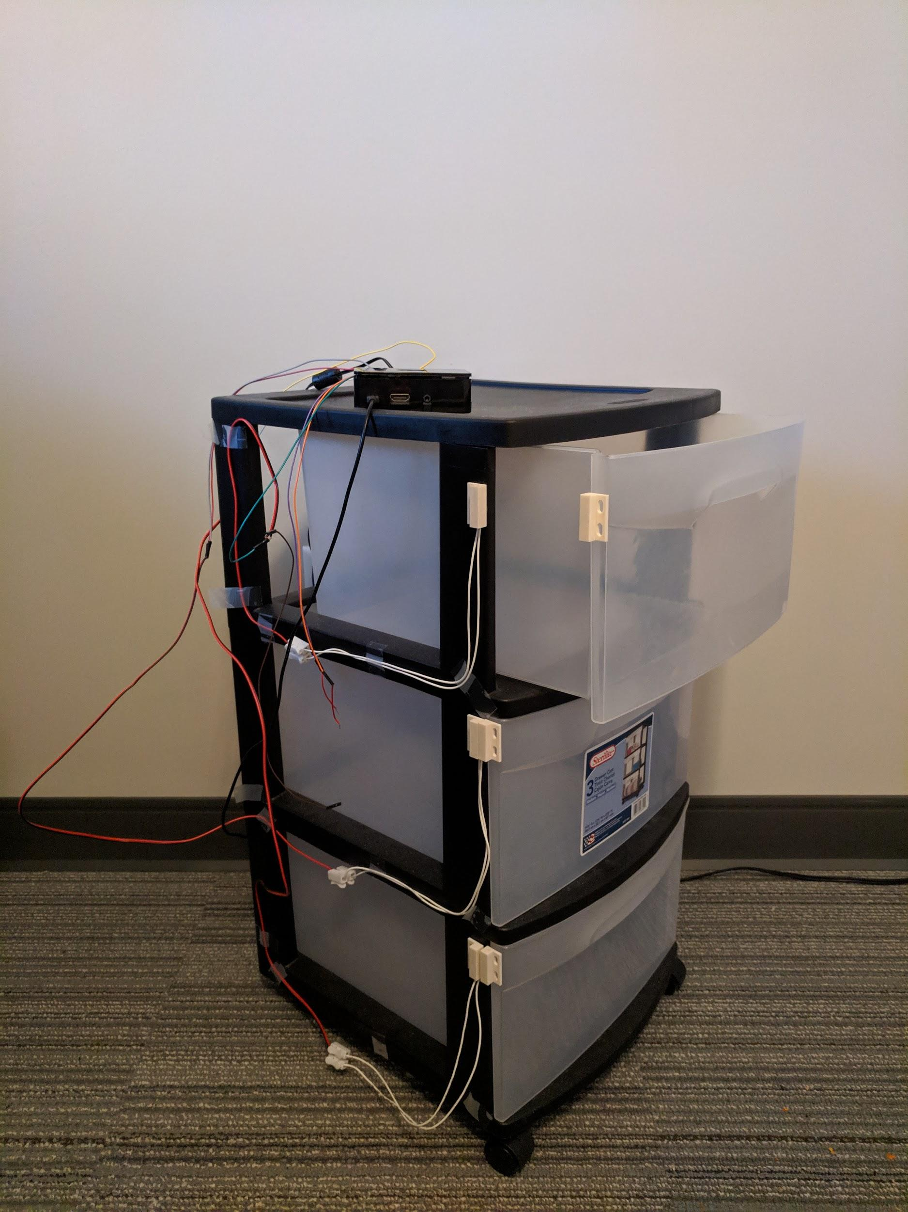
Prototype Implementations
Sensor hardware
Logic Server
Kitchen activities monitor.
Web Application
Notes:
Jared, Siyuan, Tyler

Slide 20
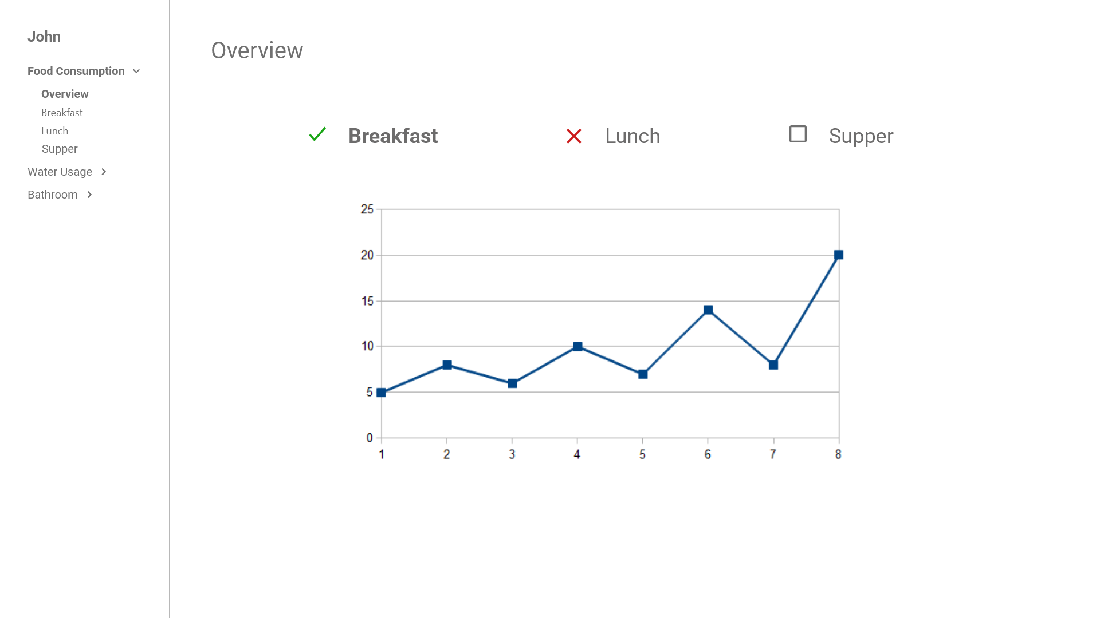

Slide 21
Project Milestones
Sensor
Fixing current solution and test
Research and implement a new wireless solution
Implement it into testing environment
Logic
View raw in a human readable format
Prediction for breakfast, lunch and dinner
Web Application
Displaying raw data
Graphing data to make it more understandable
Integrate logic assumptions
Notes:
Jared, Nidhi, Siyuan

Slide 22
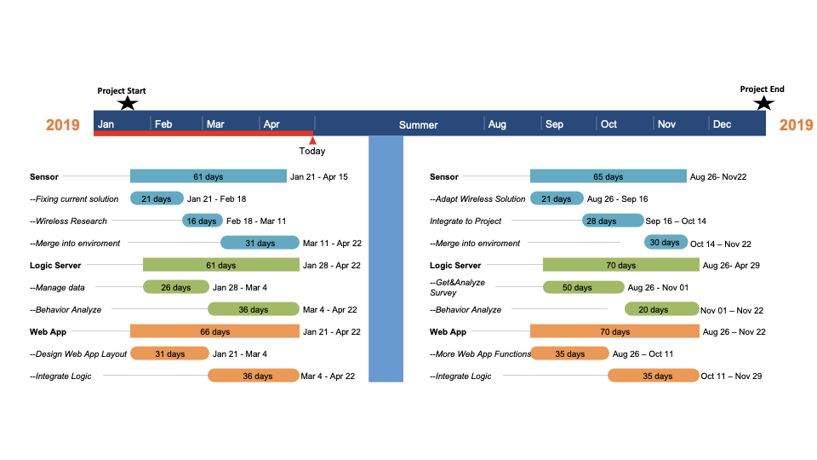
Project Milestones & Schedule
Nov 22
Notes:
Siyuan

Slide 23
Test Plan
Sensor
Unit testing with unittest
Testing the code using the prototype
Logic Server
JUnit Test (For Unit tests.)
Mockito Test (For Integration Tests.)
Web Application
Unit Testing
Acceptance & Integration Tests
Notes:
Jared,
Siyuan: JUnit is the default spring unit test to test each individual class works as expected. Mockito test is a third party test when you want to do a integration test. If you haven’t finished a specific class, but you want to test a function that depend on this class, Mockito allow you to pretend the class is finished so you can progress your function test.
Tyler:
For the sensor hardware we plan to drive the basic functionality of the python code with unittest. To test the physical hardware we will need to execute test cases to accurately represent real world use.

Slide 24
Project Status
Sensor Hardware
Fixed previous solution
Researched a wireless solution for next semester
Logic Server
Kitchen activities monitor
Meal prediction logic.
Web Application
Project bootstrapping
Continuous integration workflow
UX mockups being developed for next semester
Notes:
Jared, Siyuan, Tyler

Slide 25
Plan for next semester
Sensor hardware
Implement wireless solution into prototype
Replace old solution with wireless
Logic Server
Make more survey to get detailed information for implementing logic.
Better logic algorithm.
Web Application
Implement the UX mockups created this semester
Integrate behavioral logic
Notes:
Jared, Robert, Nidhi

Slide 26
Summary
Helping monitor the health of senior citizens
System addresses this by:
Collecting data from the seniors’ homes
Analyzing their behavior
Displaying health information in a web application
[14]

Slide 27
References
[1] Image from Guardians of the Grandparents
[2] https://www.purspective.com/curriculum/cost-management/
[3] http://clipart-library.com/clipart/8263.htm
[4] https://ui-ex.com/images/boxes-clipart-packaging-3.png
[5] https://www.vitaltech.com/vitalcare-1
[6] https://www.pinclipart.com/maxpin/xmwJmo/
[7] https://www.kisspng.com/png-failover-virtual-private-network-computer-icons-re-1209842/preview.html
[8] https://www.mouser.com/images/marketingid/2016/img/169604838_TexasInstruments_CC1350STKUSSensorTagDevelopmentKit.png
[9] http://www.wikiwand.com/en/Conditional_(computer_programming)
[10] https://daproim.com/web-application-development/
[11] https://aws.amazon.com/ec2/pricing/on-demand/
[12] https://aws.amazon.com/rds/mysql/pricing/
[13] https://aws.amazon.com/s3/pricing/
[14] https://images.pexels.com/photos/1418355/pexels-photo-1418355.jpeg?cs=srgb&dl=adult-casual-chef-1418355.jpg&fm=jpg
[15] http://instrument-works.com/sensortag-2-0-now-compatible-with-dataworks/
[16] https://shop.pimoroni.com/products/raspberry-pi-zero-w
[17] https://www.digikey.com/product-detail/en/texas-instruments/CC1350STKEU/296-45490-ND/6821172
[18] http://www.ti.com/tools-software/sensortag.html
[19] https://encrypted-tbn0.gstatic.com/images?q=tbn:ANd9GcRGuoB0k5AuX1-Mi01Wp7_WY6LyHMrLxK-NfOtstDsptBZORMHADA
[20] https://i.ya-webdesign.com//images/extinguisher-clipart-chlorofluorocarbon-5.png
[21] https://www.tp-link.com/us/products/details/cat-5516_HS110.html
[22] http://clipart-library.com/image_gallery/15754.png
[23] https://www.kisspng.com/png-human-brain-artificial-intelligence-machine-learni-5781624/download-png.html

Slide 28
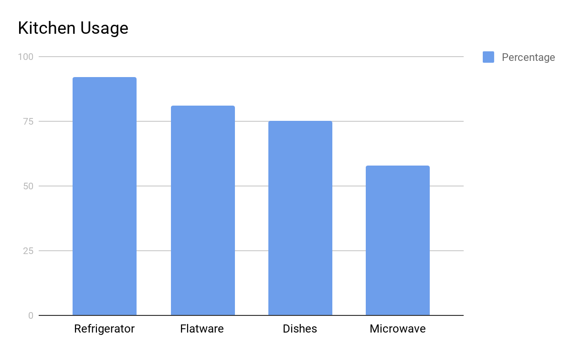
Appendix A

